Slide 1
PRESENTATION ON BANGLADESH DEFENSE
NAME: MD. MOMINUL ISLAM SHIZAN ID: 18.02.04.117
Group:B2

Slide 2
OUTLINE
Bangladesh Armed Forces
Bangladesh Army & their activities
Bangladesh Navy & their activities
Bangladesh Air force & their activities
Women in Defense

Slide 3

Bangladesh Armed Forces
Motto: “Ever High is My Head”
Founded:
Service branches:
Commander-in-Chief: President of Bangladesh
4 April 1971 (Mukti Bahini)
21 November 1971 (Official)
Bangladesh Army
Bangladesh Navy
Bangladesh Air Force

Slide 4



Tri-service Logo of Bangladesh Armed Forces
Bangladesh Army
Bangladesh Navy
Bangladesh Air Force

Slide 5
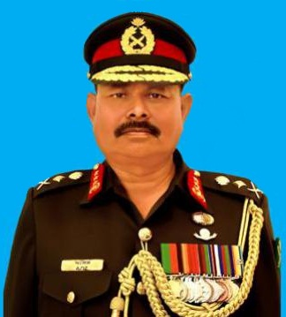
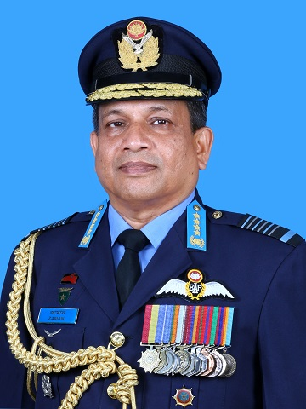
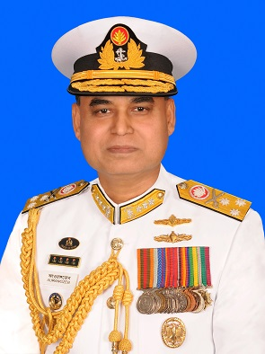
Chief of
Army Staff
Chief of
Air Staff
Chief of
Naval Staff
General Aziz Ahmed
BSP, BGBM, PBGM, BGBMS, psc
Vice Admiral Aurangzeb Chowdhury
NBP, OSP, BCGM, PCGM, BCGMS, ndc, psc
Air Chief Marshal Masihuzzaman Serniabat
BBP, OSP, ndu, psc

Slide 6

Bangladesh Army
Active : 26 March 1971 – present
Type : Land warfare
Part of : Bangladesh Armed Forces
Headquarters: Dhaka Cantonment
Nickname : BA
Motto:
“In Peace or In War We are Everywhere for our country"

Slide 7
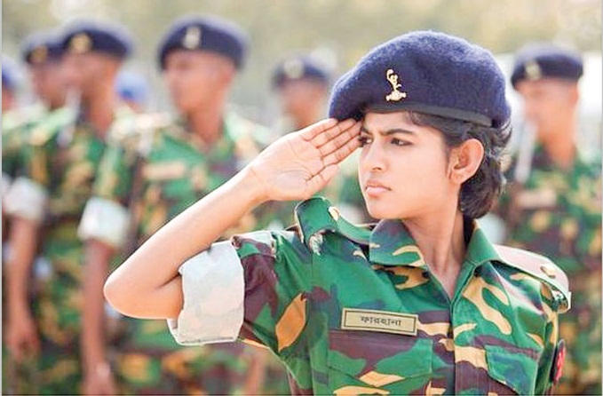
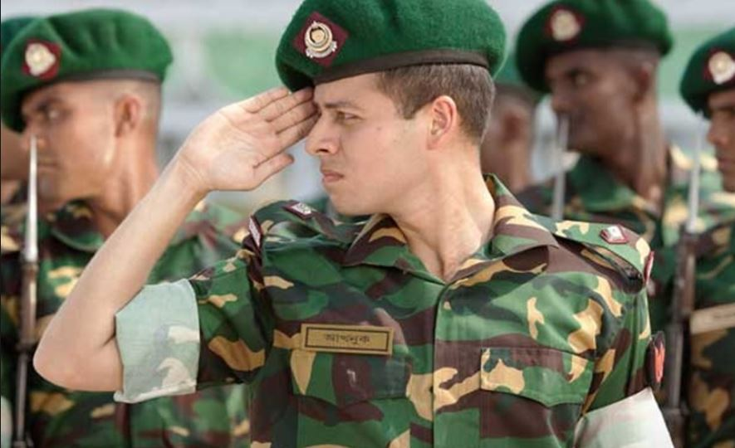

Slide 8
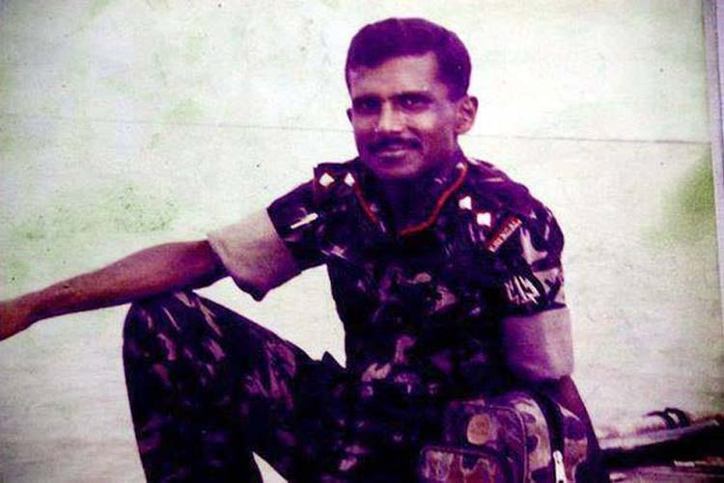
Does anybody know this person?

Slide 9
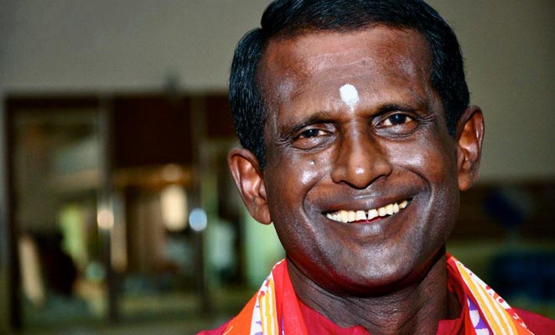
Capt. Hasan Masood (retd.)

Slide 10

Activities of Army
The main purpose is to protect our beloved mother land
Bangladesh. They spread around border, standing like a shield
so that the counterparts never can take chance to get in.
Though they are at the border,
they maintain the internal security of our country.

Slide 11
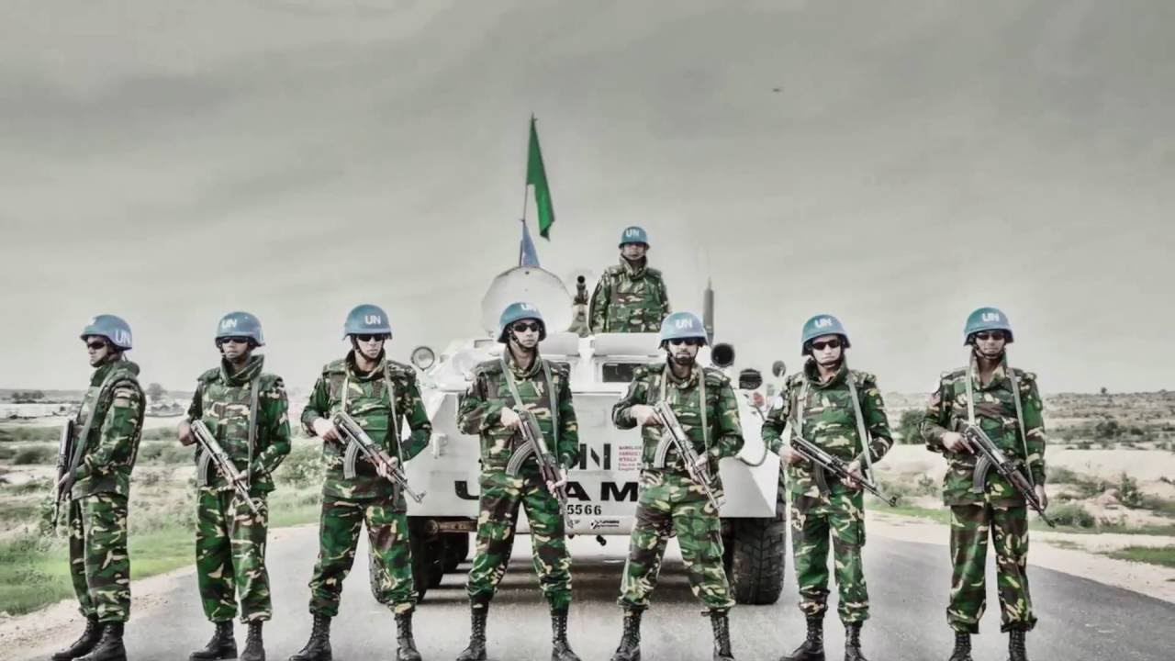
Not only for the country’s need but also they are
joining at UN mission for world peace and brighten
Bangladesh across the border.
In war, in peace the army is are
everywhere for our country.
For more information :
www.army.mil.bd

Slide 12

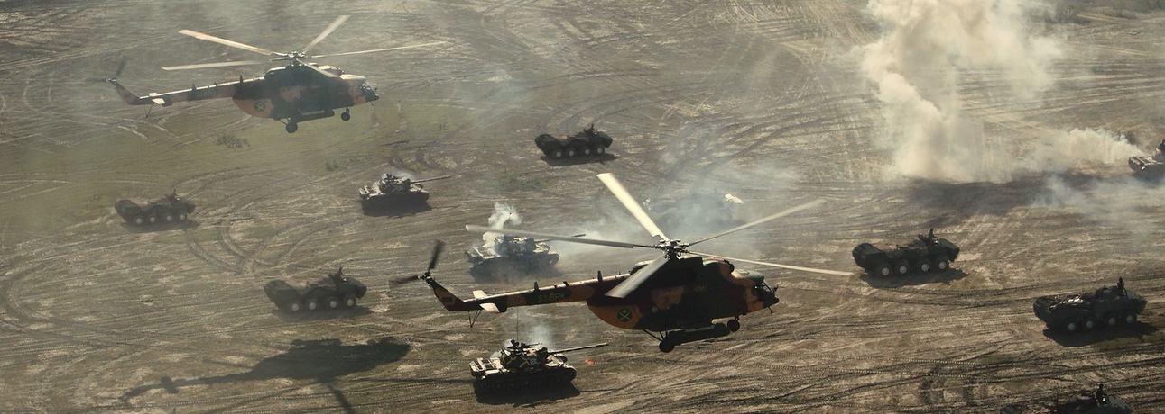

Slide 13

Bangladesh Navy
Active : 7 November 1971 – present
Type : Naval warfare
Part of : Bangladesh Armed Forces
Headquarters : Dhaka Cantonment
Nickname : BN
Motto:
“In War and Peace Invincible at Sea”

Slide 14

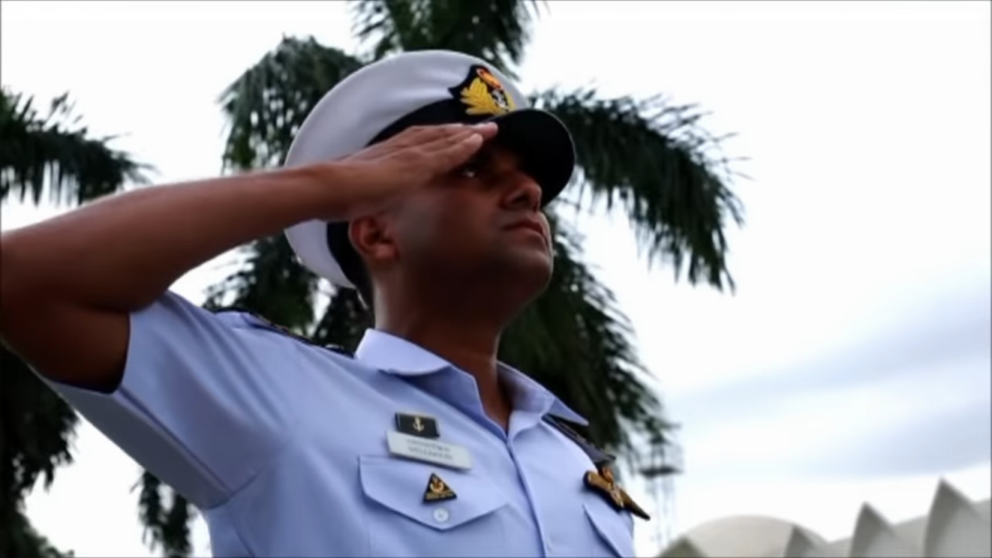

Slide 15
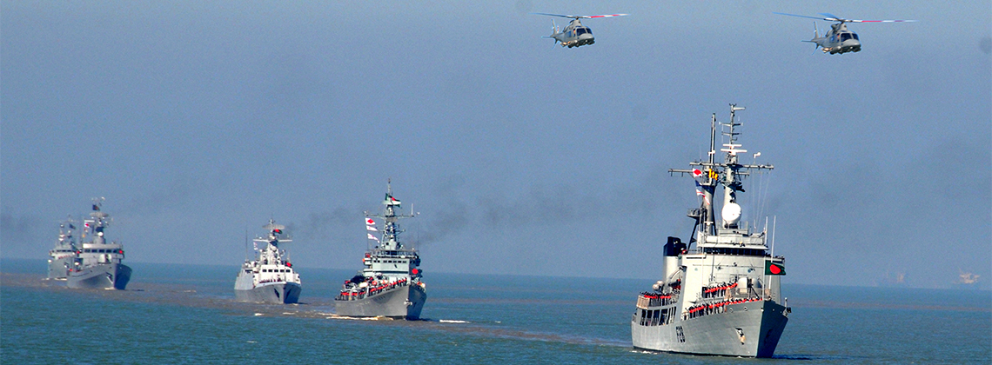
Activities of Navy
They control and secure our shipping ways, seaports and rivers.
They protect general people, leaving near shore and banks from robbers, prevent doing illegal business on water ways.
They also help affected people during post natural disaster .
For more information :
www.navy.mil.bd

Slide 16
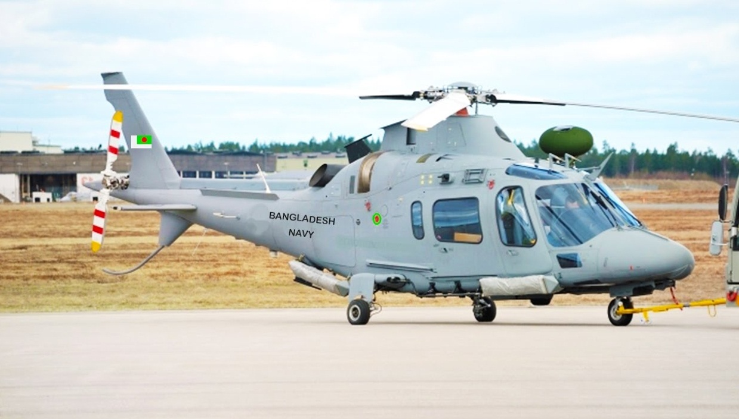
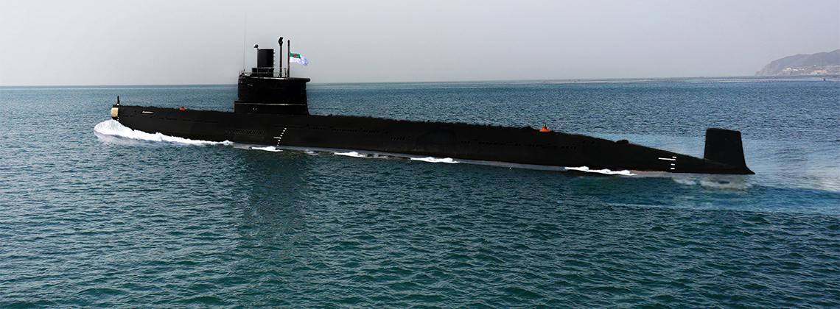
Naval Aviation
Country’s first two
submarines commissioned
Nabajatra
Joyjatra

Slide 17

Bangladeshi Air Force
Active : 1971–present
Type : Aerial Warfare
Part of : Bangladesh Armed Forces
Headquarter : Dhaka Cantonment
Nickname : BAF
Motto:
“ Bengal's Sky Will be Kept Free”

Slide 18
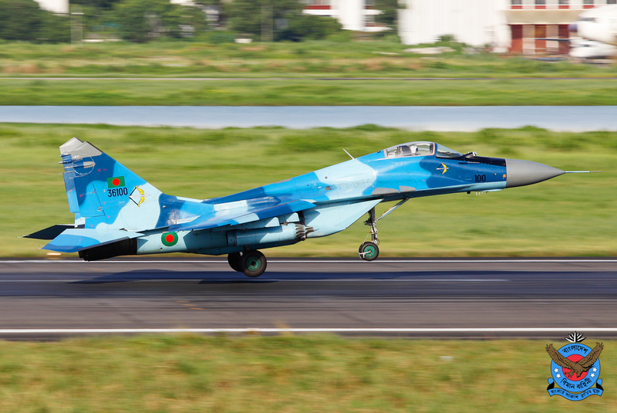
Activities of BAF
Bangladesh Air Force is always concern to protect our
airways at any cost with high technological rudder system,
fighter planes, helicopter as well.
Mig-29

Slide 19
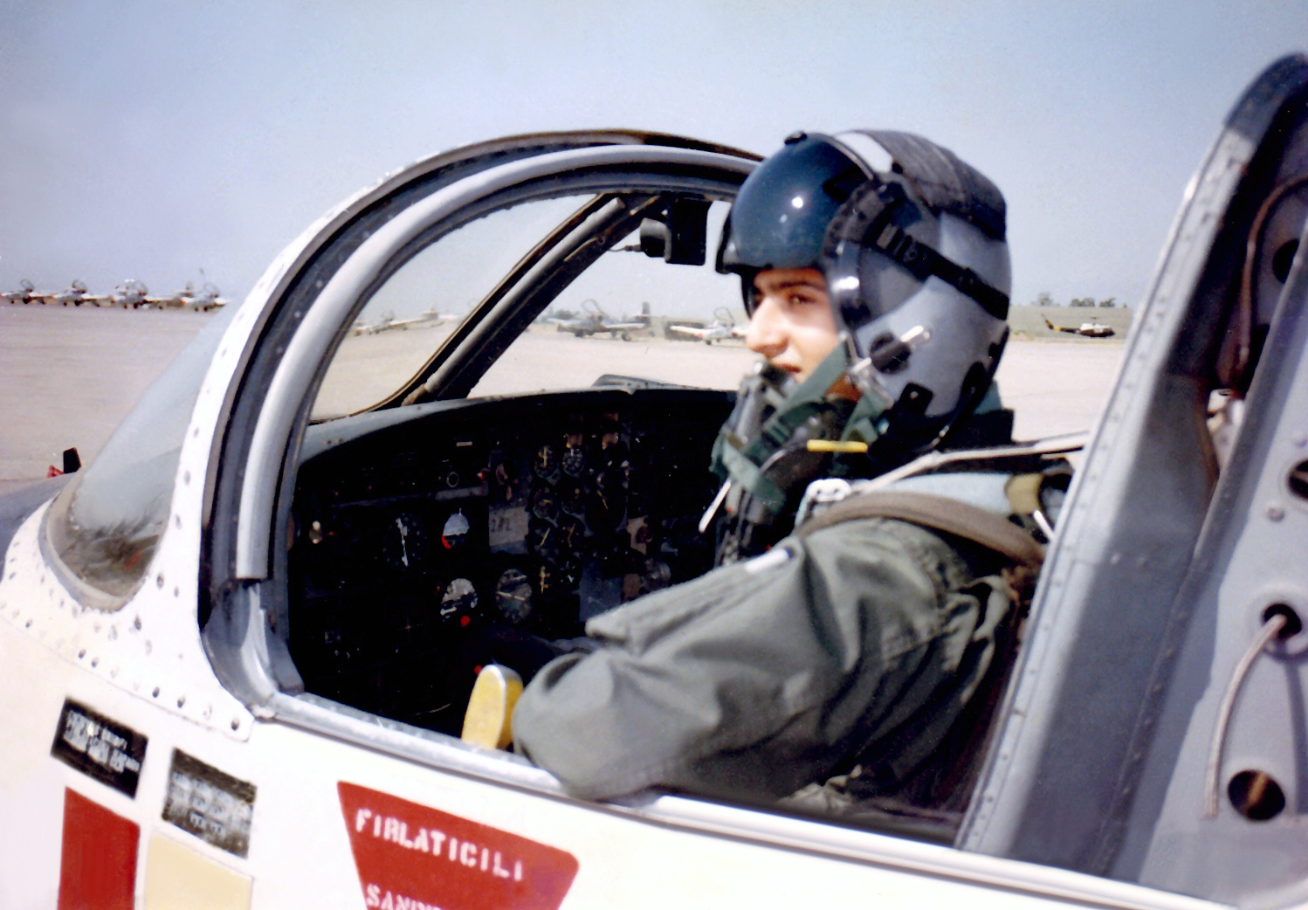
Who is this person?

Slide 20


Actor Riaz

Slide 21

Aircrafts of Bangladesh Air force are seen flying, displaying colors of the
national flag, during the parade at the National Parade Ground
For more information :
www.baf.mil.bd

Slide 22
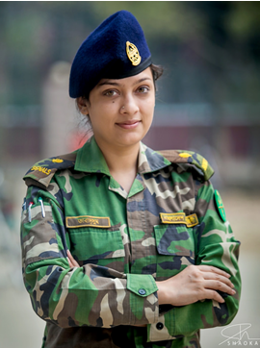


Women in Defense: Now-a-days women are joining Bangladesh
Defense by showing there talents, skills and dignity besides man.
1. Susane Giti first female major general
2. First woman Brigadier of Bangladesh Suraiya Begum.
3. Captain Jannatul Ferdous has attained rare pride to be the
first Bangladeshi woman paratrooper.

Slide 23
Any Question?
Thank you

